Slide 1
Compiler Design
Grammars & Parsers
Saeed Parsa
Room 332,
School of Computer Engineering,
Iran University of Science & Technology
parsa@iust.ac.ir
Spring 2021

Slide 2
Backus-Naur Form (BNF) notation
Backus-Naur form (BNF) is a formal notation for encoding grammars intended for human consumption.
Every rule in Backus-Naur form has the following structure:
name ::= expansion
or
name → expansion
The symbols ::= and → mean "may expand into" or "may be replaced with”.
A name is also called a non-terminal symbol.
Every name in Backus-Naur form is surrounded by angle brackets, < >.
An expansion is an expression containing terminal symbols and non-terminal symbols, joined together by sequencing and choice.

Slide 3
Backus-Naur Form (BNF) notation
A terminal symbol is a literal like ("+" or "function") or a class of literals (like integer).
Simply juxtaposing expressions indicates sequencing.
A vertical bar | indicates choice.

Slide 4
Backus-Naur Form (BNF) notation
For example, in BNF, the classic expression grammar is:
<expr> ::= <expr> "+" <term>
| <expr> “-" <term> | <term>
<term> ::= <term> "*" < factor>
| <term> “/" < factor>| <factor>
<factor> ::= "(" <expr> ")"
| number | identifier
Start symbol
Non-terminal symbols

Slide 5
Extended BNF (EBNF) notation
Extended Backus-Naur form (EBNF) is a collection of extensions to Backus-Naur form.
Not all of these are strictly a superset, as some change the rule-definition relation ::= to =, while others remove the angled brackets from non-terminals.
More important than the minor syntactic differences between the forms of EBNF are the additional operations it allows in expansions:
Grouping operator: (…)
Optional operator: […]
Repetition operator (zero or more): {…}

Slide 6
Extended BNF (EBNF) notation
For example, in EBNF, the classic expression grammar is:
expr ::= <expr> ("+" | “-”) <term>
| <term>
<term> ::= <term> ( "*“ | “/”) <factor>
| <factor>
<factor> ::= "(" <expr> ")"
| <signed> | <string> | identifier
<signed> ::= [“+” | “-” ] number
<string> ::= “ character { character } “
Grouping
Optional
Iteration

Slide 7
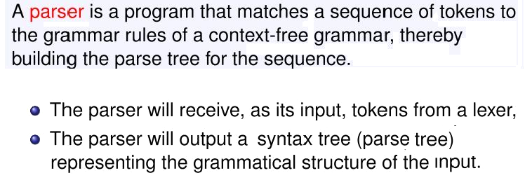
Syntax/Parse trees
Syntax trees are created to show and evaluate the grammatical structure of statements (programs).
To evaluate the syntax of a statement / program, the parser operates on a stream of tokens that are generated by the lexical analyzer.

Slide 8
Example
We want to find parts of speech in this sentence.
She loves animals.

Slide 9
Example
First, you broke up the sentence into parts (words).
She loves animals
whitespace demarcates the parts

Slide 10
Example
Second, you identified each part's type.
She loves animals
pronoun
verb
noun

Slide 11
Example
That's parsing!
Third, you diagrammed the sentence.
Sentence
pronoun
verb
noun
She
loves
animals

Slide 12
Example
Parsing is nothing but structuring a linear sequence of parts.
Sentence
pronoun
verb
noun
She loves animals
parse
She
loves
animals
linear sequence of parts
structured parts

Slide 13
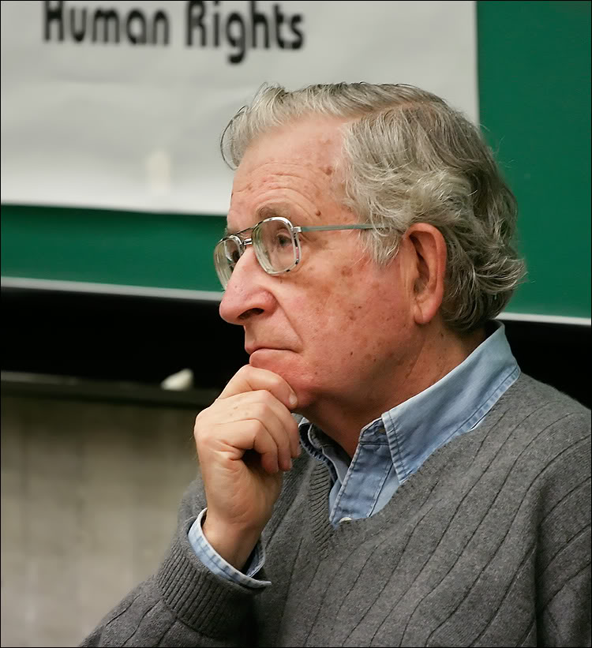
Example
In our brain, we automatically convert a linear sequence of parts into a parse tree in order to understand.
Noam Chomsky (linguist)

Slide 14
How to write parser?
Description of how to break up the linear sequence into parts
lexer rules
This tutorial teaches you how to write these.
Parser
Generator
Parser
Description of how to structure the parts
parser rules

Slide 15
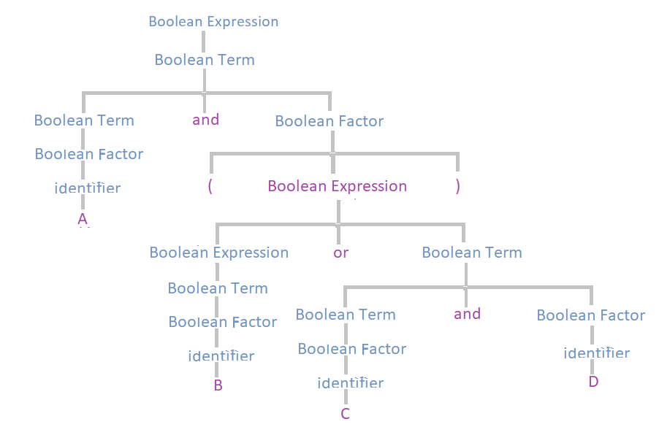
How to write parser?
<Boolean expression> ::=
<Boolean expression> or <Boolean term>
| <Boolean Term>
<Boolean term> ::=
<Boolean term> and <Boolean factor>
| <Boolean factor>
<Boolean factor > ::=
( <Boolean expression > )
| number
| identifier
Statement: A and (B or C and D)

Slide 16
Top-down parsing
Top-down parsing begins with the root of the parse tree and extends the tree downward until leaves match the input string.
In Top-down parsing We start from the nonterminal start symbol S and apply every rule that can replace the nonterminal symbol with other nonterminal symbols or terminal symbols.
In turn, new nonterminal symbols are further replaced by their rewriting rules from left to right, until all symbols are terminal symbols of the string.

Slide 17
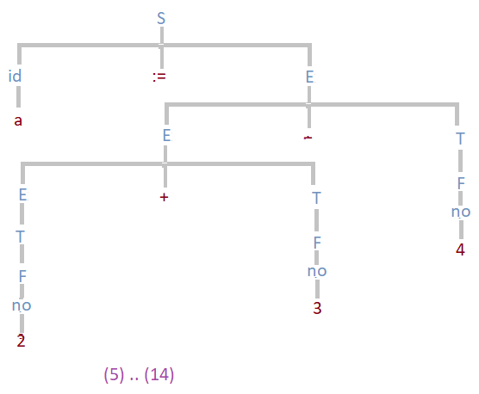
Top-down parsing
Top-down parsing begins with the root of the parse tree and extends the tree downward until leaves match the input string.
Example:
S → id := E
E → E + T | E – T | E or T | T
T → T * F | T / F | T and F | F
F → id | no | (E) | not E
Statement: a := 2 + 3 – 4

Slide 18
Sentential Form
Top-down parsing methods starts with the start symbol and tries to produce the input from it.
At any point in time, it replaces the leftmost nonterminal with the right hand side of one of the rules, defining the nonterminal symbol.
In this way, sentential forms are created.
A sentential form is any string derivable from the start symbol.
A sentential form is the start symbol S of a grammar or any string that can be derived from S.
The leftmost derivation is the one in which you always expand the leftmost non-terminal. The rightmost derivation is the one in which you always expand the rightmost non-terminal.

Slide 19
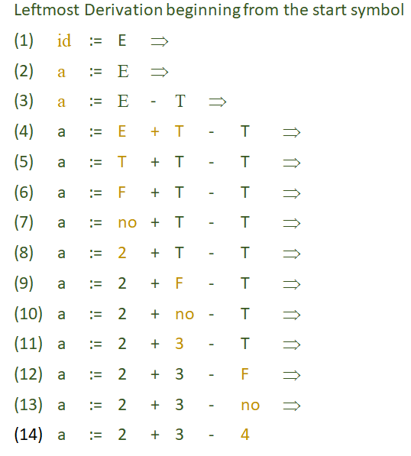
Top-down parsing: Example

Slide 20
Bottom-up parsing
Also known as shift‐reduce parsing, LR family or Precedence parsing
Shift: allow shifting input characters to the stack, waiting till a matching production can be determined
Reduce: once a matching production is determined, reduce
Follow the rightmost derivation, in a reversed way
Parse from bottom (the leaves of the parse tree) and work up to the starting symbol
Due to the added “shift”
- More powerful
Can handle left recursive grammars and grammars with left factors
- Less space efficient

Slide 21
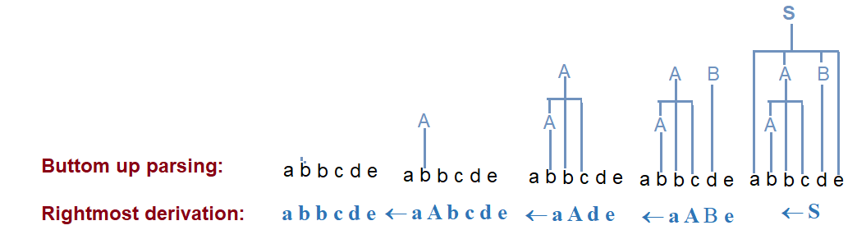
Bottom-up parsing
Build the parse tree from leaves to root.
Bottom-up parsing can be defined as an attempt to reduce the input string w to the start symbol of grammar by tracing out the rightmost derivations of w in reverse.
Eg.
S → aABe
A → Abc | b
B → d
Input: a b b c d e

Slide 22
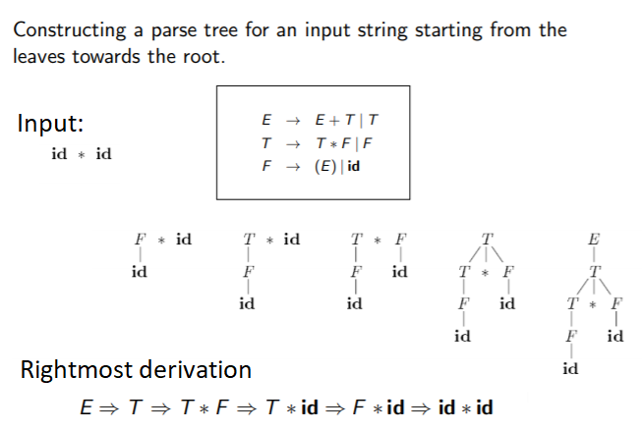
Bottom-up parsing

Slide 23
Ambiguous Grammar
When a grammar permits several different syntax trees for some strings, we call the grammar ambiguous.
How do we know when a grammar is ambiguous?
In fact, the problem is formally undecidable.
If we can find a string and show two alternative syntax trees for it, the grammar is ambiguous.
If a single production rule is both left and right recursive, the grammar is ambiguous. For example: A → αA ∣ Aα

Slide 24
Ambiguous Grammar
If a single production rule is both left and right recursive, the grammar is ambiguous. For example, the following rule
A→ αA ∣ Aα
has the following two (left-most) derivations:
1. A ⇒ αA ⇒ αAα corresponding to the grouping (α(Aα))
2. A ⇒ Aα ⇒ αAα corresponding to the grouping ((αA)α)
So, the grammar is ambiguous!

Slide 25
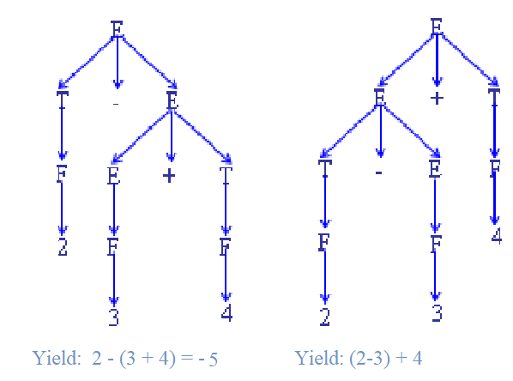
Ambiguous Grammar: Example
G1:
E ::= E + T | T – E | T
T ::= T * F | T / F | F
F ::= ( E ) | id | no
Input string:
2-3+4

Slide 26
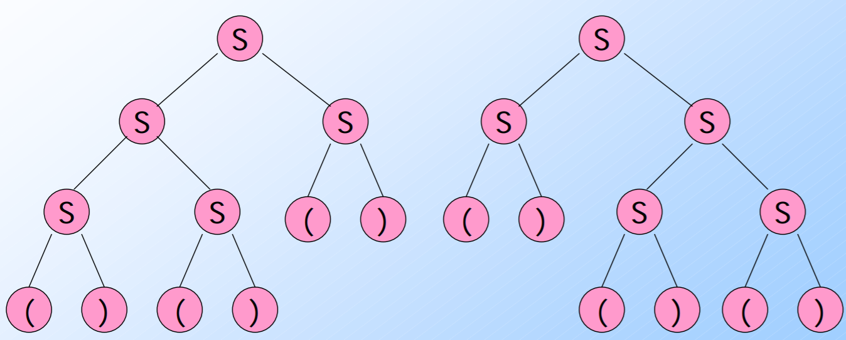
Ambiguous Grammar
A CFG is ambiguous if there is a string in the language that is the yield of two or more parse trees.
Example:
S -> SS | (S) | ()
There are two parse trees for ()()():

Slide 27
Ambiguous Grammar: Example
Statement → IfSt | WhileSt | ForSt | CaseSt | CompundSt | AssSt | CallSt
IfSt → if Condition then Statement ElsePart
ElsePart → else Statement | λ
Condition → E Relop E | E
Relop → < | <= | <> | = | >= | >
E → E + T | E – T | T
T → T * F | T / F | F
F → id | no | ( E )
There are two parse trees with two different semantics for the statement:
if a > 5 then if a < 7 then writeln(‘a = 6’) else writeln(‘a >= 7‘)

Slide 28

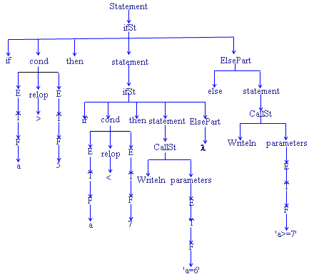
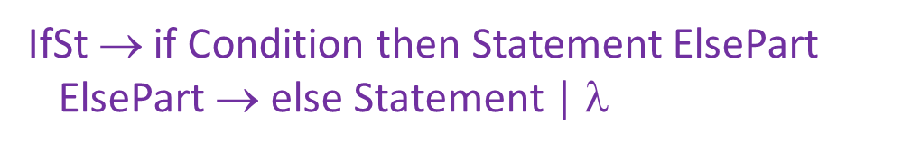
Ambiguous Grammar: Example

Slide 29

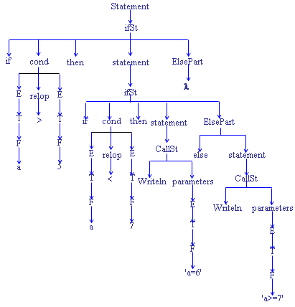
Ambiguous Grammar: Example

Slide 30
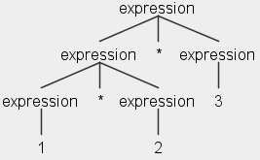
Operator association in ANTLR
Consider this parser rule for arithmetic expressions: expression: expression MULT expression | INT ;
Question: How will this input be parsed: 1 * 2 * 3
Answer: By default, ANTLR associates operators left to right, so the input is parsed this way: (1 * 2) * 3

Slide 31
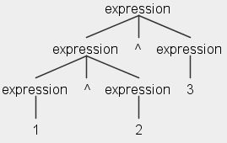
Operator association in ANTLR
Suppose the arithmetic operator is exponentiation (^): expression : expression EXPON expression | INT;
Question: How will this input be parsed: 1 ^ 2 ^ 3
Answer: Again, the default is to associate left to right, so the input is parsed this way:
(1 ^ 2) ^ 3
However, that's not right.
The exponentiation operator should associate right-to-left, like this: 1 ^ (2 ^ 3)

Slide 32
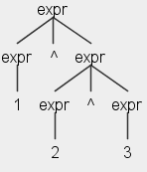
Operator association in ANTLR
We can instruct ANTLR on how we want an operator associated, using the assoc option: expr : <assoc=right> expr '^' expr | INT ;
Now this input 1 ^ 2 ^ 3 is parsed this way 1 ^ (2 ^ 3).

Slide 33
Problem
Create a grammar for such inputs:
2 9 10 3 1 2 3
indicates that there are 2 following integers
indicates that there are 3 following integers

Slide 34
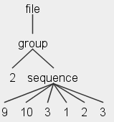
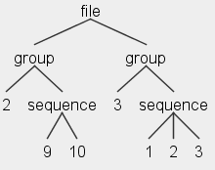
Answer
lexer grammar MyLexer;
INT : [0-9]+ ;
WS : [ \t\r\n]+ -> skip ;
Here's the parse tree that is generated for the input:
2 9 10 3 1 2 3
parser grammar MyParser;
options { tokenVocab=MyLexer; }
file: group+ ;
group: INT sequence ;
sequence: ( INT )* ;
Here is the parse tree we desire for:
2 9 10 3 1 2 3
No restriction on the number of INT values within sequence.

Slide 35
Answer
Source File: 2 9 10 3 1 2 3
This is what we want
This is what we get

Slide 36

Assignment 3
Subject : Languages & Grammars
Deadline: 1399/7/28
Mark: 5 out of 100.

Slide 37

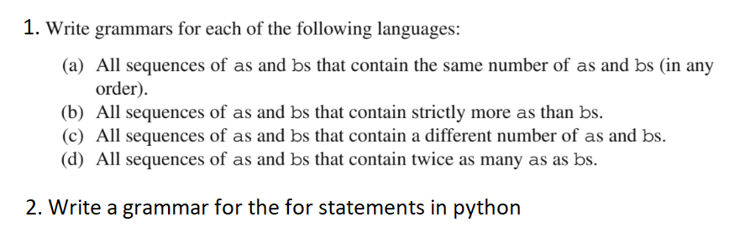
Assignment 3
Exercise 1:

Slide 38
Assignment 3
Answers Ex.1:
1. Write a grammar
(a) S ::= a S b | b S a | λ
(b) S ::= a a S b | λ
(c) S ::= a a S b | λ
(d) S ::= a a S b | λ
2. For statements in python:
<for statement> ::= for <var> in <list> :
<statements>
eg. for x in [2, 4, -10, “c”]:
print x, “@’

Slide 39
Assignment 3
Exercise 2:
1. Consider the context-free grammar:
S -> S S + | S S * | a
and the string aa + a*.
Draw the Syntax tree for the given string.
Give a leftmost derivation for the string.
Give a rightmost derivation for the string.
Give a parse tree for the string.
Is the grammar ambiguous or unambiguous? Justify your answer.
Describe the language generated by this grammar.

Slide 40
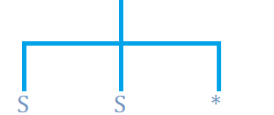
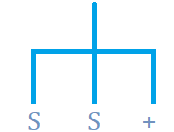


Assignment 3
Answers Ex.2:

Slide 41

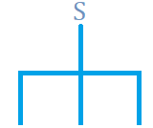



Assignment 3
Answers Ex.2:

Slide 42
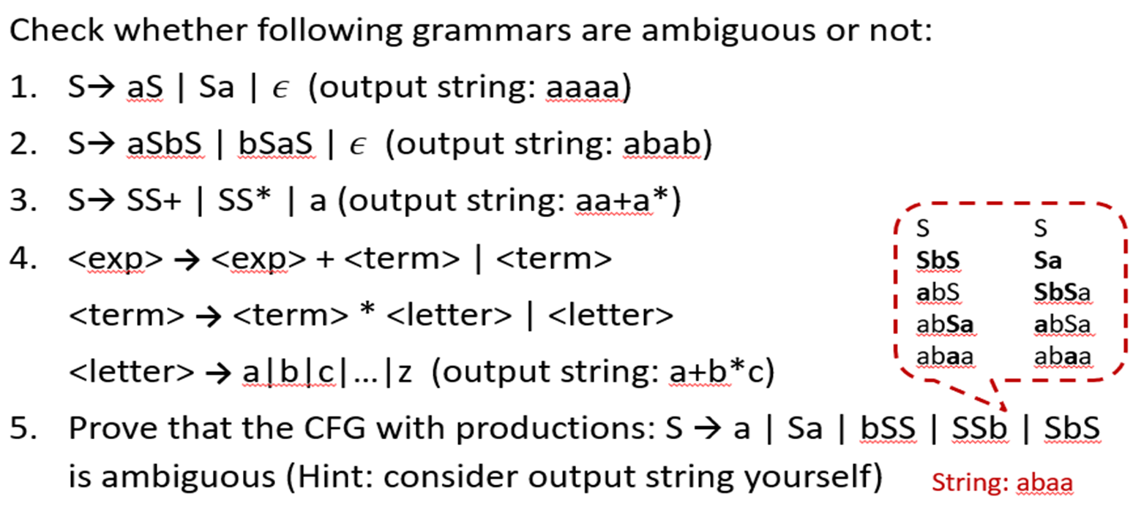
Assignment 3
Exercise 3:

Slide 43
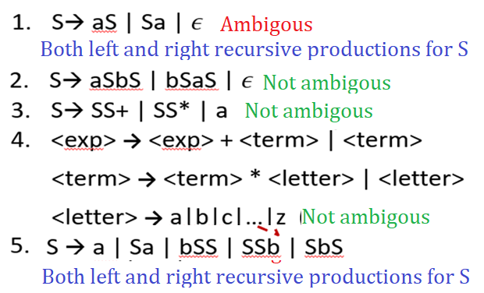
Assignment 3
Answers Ex.3:

Slide 44


